Slide 1
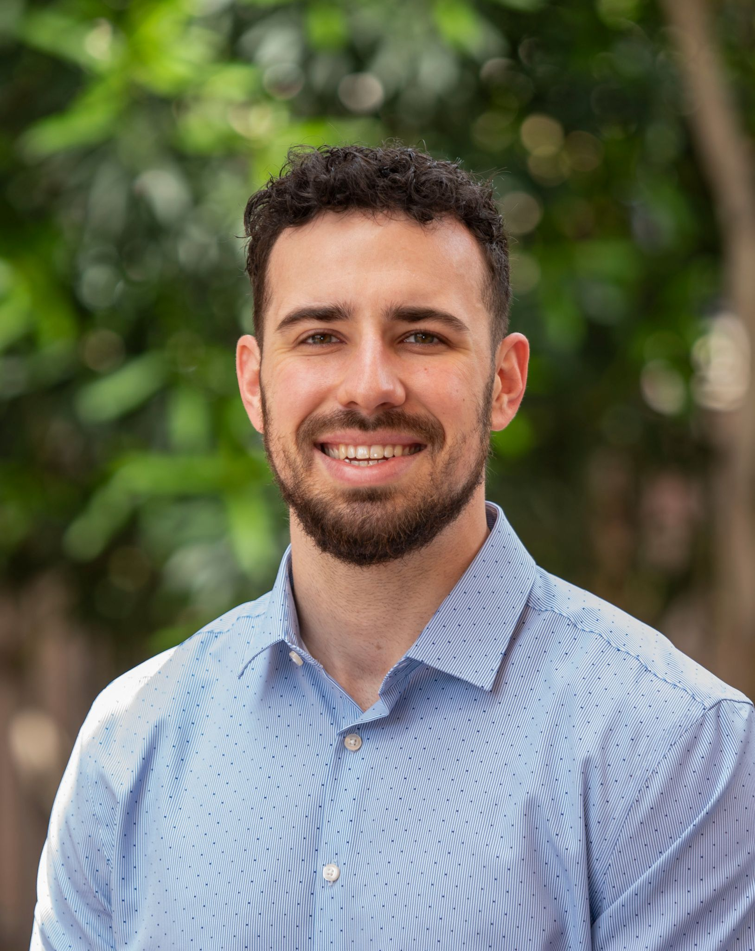
1115 Waiver Renewal
Maxwell Seifer
Federal Relations Chief
Division of Public Policy and
Strategic Planning
Notes:
Parin Kaba
Federal Relations Specialist
Division of Public Policy & Strategic Planning

Slide 2
Arizona's 1115 Waiver Overview

Slide 3
Section 1115 of the Social Security Act
Allows states the flexibility to design Demonstration projects that promote the objectives of the Medicaid program,
Demonstration projects are typically approved for a five-year period and must be renewed every five years, and
Must be budget neutral, meaning that federal spending under the waiver cannot exceed what it would have been in absence of the waiver.

Slide 4
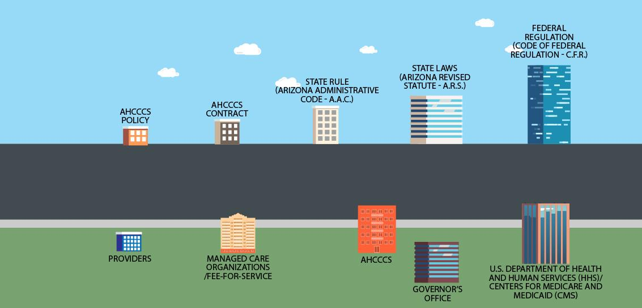


Making Health Care Change
Notes:
This slide does a great job of showing visually the regulatory text and regulatory bodies that the waiver and SP “vehicles” must meet and go through before approval.
On the top here we have some of the rules and regulations that govern out program (federal reg, state law, state rule), and then we have our AHCCCS contracts and policies, which fall under that.
On the bottom, we have the entities that help AHCCCS oversee compliance with these rules and regulations (starting with CMS, GO, AHCCCS), all the way down to our MCO and provider partners.

Slide 5
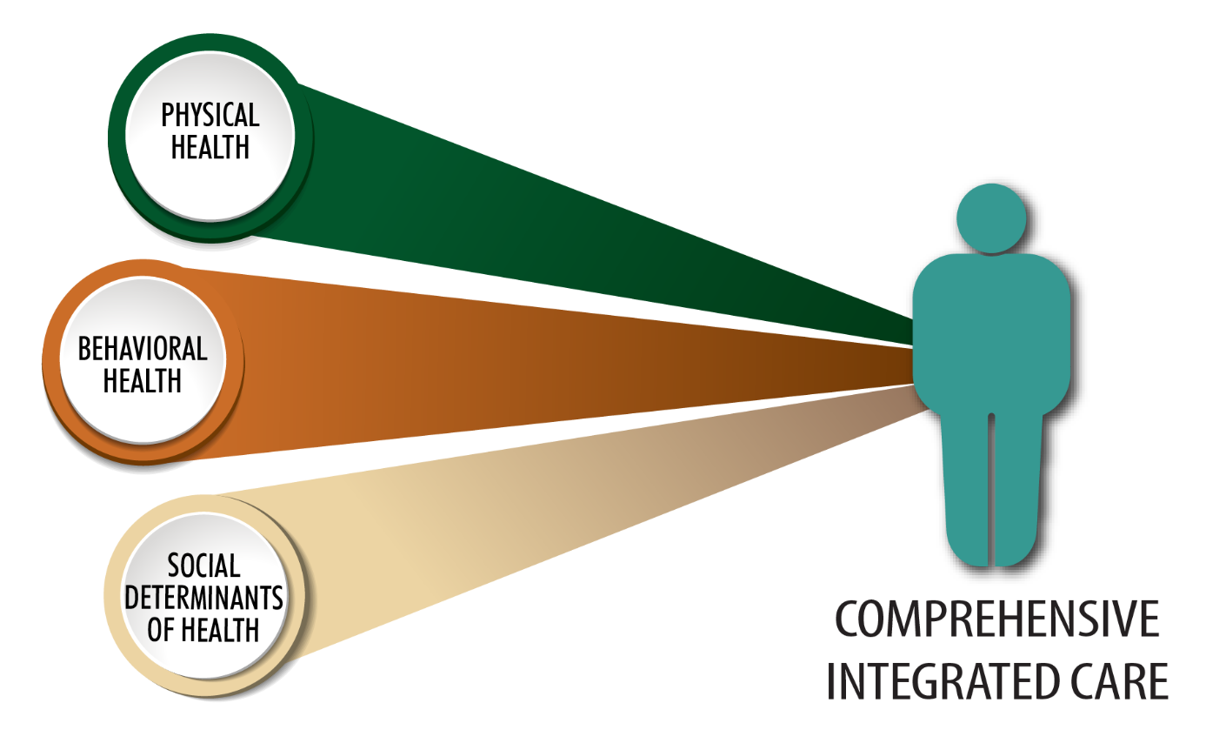
Current 1115 Waiver
On October 14, 2022, CMS approved Arizona’s request for a five-year extension of its 1115 Demonstration Waiver.
  Valid from October 14, 2022, through September 30, 2027.
Continues:
  Managed Care
    ACC
    ALTCS
    DCS CHP
    ACC-RBHA
  HCBS
  And many more programs

Slide 6
Current 1115 Waiver and Renewal
In addition to continuing many longstanding programs, AHCCCS also received approval on a variety of new programs:
  Targeted Investments (TI) 2.0,
  Housing and Health Opportunities (H2O),
  KidsCare Eligibility Expansion,
  Parents as Paid Caregivers,
  Tribal Dental Benefit,
  Traditional Healing services, and
  Pre-release services.
AHCCCS is now seeking to renew its 1115 Waiver Authority for many of these programs.
AHCCCS must submit its waiver renewal application by September 30, 2026

Slide 7
1115 Waiver Renewal
As a reminder, in May 2025, Arizona’s Legislature passed HB 2945:
  Institutes a new requirement for AHCCCS to first gain legislative approval prior to submitting any new 1115 Waiver Program that:
    Expands eligibility,
    Adds new services, or
    Will lead to an annual increase in utilization greater than 10%.

Slide 8
Arizona’s 1115 Waiver Renewal Timeline
July
1115 Waiver Renewal Draft & Interim Evaluation Report available to public
Winter 2026 & 2027
CMS Negotiations
July - August
Formal 1115 Waiver Renewal Public Comment Period, including Tribal Consultation
June
Waiver Listening Sessions
January
Start of 2026 Arizona Legislative Session
2025
2026
2027
Aug. - Sep.
AHCCCS researches potential new waiver programs
Aug. - Sep.
AHCCCS reviews public comment and finalizes proposal
By Sep. 30
AHCCCS formally submits its 1115 Waiver Renewal application to CMS.

Slide 9
Budget Neutrality
Effective January 1, 2027, CMS will use a new approach to evaluate budget neutrality:
  CMS Chief Actuary must certify Demonstrations and renewals must demonstrate they are not expected to increase federal Medicaid spending
  CMS will not rely on WW/WOW methodology
  States will need to provide additional financial analyses and documentation for innovative demonstration initiatives.
  Carryforward of budget neutrality savings will be more limited than under the current policy.
Budget neutrality means a Section 1115 demonstration cannot increase federal Medicaid spending compared to what would have been spent without the waiver.
Historically, states estimated:
  With Waiver (WW): Expected federal spending with the demonstration.
  Without Waiver (WOW): Expected federal spending if the demonstration did not exist.
States could carry forward up to 10 years of accumulated budget neutrality savings.
Notes:
Arizona's current renewal is expected to see minimal impact due to transitional savings.
Future waiver proposals will require more rigorous financial analysis and planning to meet new federal requirements.

Slide 10
Budget Neutrality, Cont.
New budget neutrality will be calculated through the designation of Medicaid Authorizable Populations and Services (MAPS) and activities that can only be federally matched under Section 1115 authority (1115 Only).
  MAPS Demonstrations are when the service and the underlying population receiving the service can be authorized under the State Plan or other authority.
    MAPS expenditures will be considered budget neutral by definition and therefore would not require separate actuarial certification.
  1115 Only authorities are activities only allowable through the 1115.
    1115 Only expenditures remain subject to actuarial review and certification.
Notes:
Arizona's current renewal is expected to see minimal impact due to transitional savings.
Future waiver proposals will require more rigorous financial analysis and planning to meet new federal requirements.

Slide 11
Budget Neutrality, Cont.
For 1115 Only programs, States will be required to demonstrate through rigorous analysis that these initiatives are not expected to increase federal spending.
Analysis will need to be conducted separately for each individual 1115 program within the waiver, however, will be combined at the end to determine if the waiver as a whole is budget neutral on a net basis.
Savings from the previous five-year period or previous waiver demonstration period (whichever is shorter) will be allowed to be carried forward to the next waiver period.
Going forward, MAPS programs will no longer generate savings.
Notes:
Arizona's current renewal is expected to see minimal impact due to transitional savings.
Future waiver proposals will require more rigorous financial analysis and planning to meet new federal requirements.

Slide 12

1115 Waiver Renewal Overview
Programs Continuing As-Is:
Mandatory Managed Care
Arizona Long Term Care System(ALTCS)
Parents as Paid Caregivers (PPCG)
Tribal Dental Authority*
Tribal Uncompensated Care*
Prior Quarter Coverage (PQC)
Re-entry pre-release Services
KidsCare Expansion
Former Foster Youth Eligibility and Enrollment (YATI)
Proposed Modifications:
Traditional Healthcare Practices*
Housing and Health Opportunities (H2O)
LTSS: Timeliness Waiver*
Presumptive Eligibility and Self Attestation*
(Current Proposal) Five-Year Lifetime Coverage Limit
(Current Proposal) Institutions for Mental Disease
(Sunset at end of Demonstration) Targeted Investments (T.I 2.0)
(Future Amendment) SMI Enhanced Residential Treatment Pilot
Arizona's Section
1115 Waiver

Slide 13
Questions?

Slide 14
Continuing Demonstration Programs Within the Waiver Renewal

Slide 15

Tribal Dental Authority
Authorizes payment for medically necessary diagnostic, therapeutic, and preventative dental services for American Indian/Alaska Native (AI/AN) beneficiaries.
Reimbursement for services beyond the current $1,000 dental limit for individuals age 21 or older when provided by Indian Health Services or tribally operated 638 facility.
AHCCCS seeks to renew this program and continue expanded reimbursement for medically necessary dental services provided through IHS/638 facilities.

Slide 16
Tribal Uncompensated Care Waiver
First approved by CMS in 2012, the Tribal Uncompensated Care Waiver preserves services delivered to AI/AN members in the case the Arizona Legislature or AHCCCS reduces benefits due to financial hardship.
This program was recently further codified into state law on April 13, 2026. HB 2177 requires AHCCCS to annually seek an 1115 Waiver to allow payments for covered services reduced or eliminated since September 2010, provided to AI/AN members at IHS or tribally operated facilities.
Under this renewal, AHCCCS is seeking to continue the existing authority for the Tribal Uncompensated Care Waiver and maintain an important safeguard to support Tribal healthcare systems.
Notes:
Speaking of the extension, here are a few points on what that document include.
Read points 2 and 3
Again, the extension simply allows AHCCCS to continue current program efforts, and leaves some of our more innovative proposals to be negotiated throughout the duration of this federal fiscal year, including..
Read sub-bullets.

Slide 17
Questions?

Slide 18
Demonstration Programs with Proposed Expansions / Modifications

Slide 19
Traditional Healing Overview
Traditional Healing is a system of culturally appropriate healing methods developed and practiced by generations of Tribal healers who apply methods for physical, mental, and emotional healing.
The purpose of this Waiver program is to provide culturally appropriate options for AHCCCS members to maintain and sustain health and wellness through traditional healing practices made available at, in, or as part of services offered by facilities and clinics that provide or arrange traditional healing practices.

Slide 20
Traditional Healing Overview
On October 16, 2024, CMS approved an amendment to provide coverage of traditional healing services received through Indian Health Service or facilities operated by Tribes or Tribal organizations.
This includes traditional health care practices that are provided in the community by or through IHS or tribal facility’s direct employees or contracted traditional health care practice providers.
Under this approval, traditional health care practices would be covered services in both inpatient and outpatient settings, and aid in care coordination and assist AHCCCS beneficiaries in achieving improved health outcomes.

Slide 21
Traditional Healing Timeline
2015
Traditional Healing (TH) workgroup was established.
Winter of 2016
CMS recommends a State Plan Amendment (SPA) instead of waiver for Traditional Healing Services.
2018 & 2019
No clear direction from CMS on path forward to incorporate Traditional Healing in State Plan.
2022
AZ Section 1115 Waiver approved without approval for Traditional Healing Services.
2024
CMS approved AZ request for reimbursement for Traditional Healing on October 16.
Summer of 2016
AHCCCS submits to CMS the Traditional Healing waiver proposal developed by TH workgroup.
2017
TH Workgroup re-submitted and develops a crosswalk for Traditional Healing Services.
2020
AHCCCS re-convened the TH workgroup & resubmitted a Traditional Healing waiver proposal.
2023
Conversations around Traditional Healing proposal re-initiated with CMS.
2025
Received state legislative authority & began implementation on October 1.

Slide 22
Traditional Healing Overview
Medicaid reimbursement for THCP went live October 1, 2025.
Each IHS/638 facility, in partnership with their local Tribal community, individually defines which services are most appropriate for Medicaid billing.
The covered traditional health care practices services, limitations, and exclusions shall be described by each facility (working with each tribe they primarily serve).

Slide 23
Traditional Healing Overview
To receive coverage for traditional health care practices under the demonstration, a member must meet the following criteria:
  Is a Medicaid beneficiary, and
  Is able to receive services delivered by or through IHS or Tribal facilities as determined by the facility
Under the existing demonstration, AHCCCS reimburses for services provided by traditional healers who are employed by or contracted with an IHS/Tribal 638 facility.
Traditional healers employed by or contracted with an UIO may provide reimbursable services through a care coordination agreement (CCA) with an IHS/Tribal 638 facility.

Slide 24
Traditional Healing - UIO Participation
CCA's have to be initiated by an IHS/638 facility
  Many individuals served by UIOs do not have established relationships with IHS/638 facilities.
  As a result, the CCA requirement can delay access to services and create additional administrative burden.
Several UIOs have indicated that this requirement has limited their ability to fully participate in the demonstration despite already operating established traditional healing programs.

Slide 25
Traditional Healing – UIO Expansion
The enacted 2026 Arizona Legislative Budget (Laws 2026, Chapter 132) amends existing statutes related to AHCCCS Traditional Healing to specify that services are available through the Indian Health Service (IHS), tribal facilities, or urban Indian Organizations (UIOs).
This now allows AHCCCS to seek CMS approval to lift the CCA requirement for Traditional Healing Services delivered by UIOs.
As part of this renewal, AHCCCS is now seeking the federal authority to remove the CCA requirement and allow the UIOs to participate in the program directly.
AHCCCS is also seeking CMS approval to continue all other aspects of the program as is.

Slide 26
Questions?

Slide 27
New Demonstration Program Requests

Slide 28
Long Term Services and Supports -Timeliness Waiver

Slide 29
Background - Summarized
AHCCCS began to make updates to the HCBS Needs Tool (HNT) following CMS approval of the PPCG Demonstration.
The updated HNT was briefly implemented and subsequently halted due to concerns regarding the extraordinary care review (ECR).
AHCCCS underwent emergency rulemaking with a robust public comment period to better address concerns surrounding the ECR.
The rulemaking introduced a new ECR exception process to allow for additional clinician review.
This ECR exception process may be requested by the parent or guardian if they feel their child could experience adverse impacts from the new HNT.

Slide 30
Long Term Services and Supports - Timeliness Waiver
Current federal managed care authorization timeframes were designed for standard service authorizations
  These timelines may not provide sufficient time for families to submit documentation or clinicians to fully evaluate extraordinary care needs.
CMS requirements currently allow 14 days for standard authorization decisions, decreasing to 7 days beginning October 1, 2026.
This shortened timeline may limit the ability to gather documentation and fully evaluate extraordinary care needs.
These constraints limit the effectiveness of the ECR process.

Slide 31
LTSS - Timeliness Waiver
As a result, AHCCCS is requesting a waiver to extend review timelines for the ECR exception process, up to 28 days.
During this additional period, AHCCCS will safeguard members access to care by immediately authorizing approved hours from the initial assessment
In the event of extenuating circumstances, AHCCCS also requests additional time based on individual circumstances in limited situations
This waiver authority would allow for more comprehensive, person-centered clinical review and promote access to medically necessary services that are extraordinary in nature, especially when evaluating needs of children.

Slide 32
Questions?

Slide 33
Hospital Presumptive Eligibility and Self-Attestation

Slide 34
Eligibility Related Waiver Requests
The 2026 Arizona Legislative Budget Bill contains provisions requiring AHCCCS to:
  Prohibit the use of self-attestation of Arizona residency without independent verification prior to Medicaid enrollment, and
  Eliminate the Hospital Presumptive Eligibility (HPE) program.
AHCCCS is now seeking Waiver authority to implement both above changes as required by state law.
It's important to note, absent further legislative action, this state-law requirement directing AHCCCS to pursue these waiver requests will be repealed after June 30, 2027.
Notes:
Federal changes have been to the scope and duration of retroactive coverage.

Slide 35
Hospital Presumptive Eligibility
Current federal regulation requires Medicaid programs to have a Hospital Presumptive Eligibility (HPE) program in place.
HPE allows qualified hospitals to grant temporary Medicaid coverage to an individual based on an initial eligibility determination.
  Consistent with these federal requirements, AHCCCS has maintained a Hospital Presumptive Eligibility (HPE) program. However, use of this program has been extremely limited.
Consistent with broader state and federal efforts to strengthen program integrity and improve eligibility verification processes, AHCCCS is seeking authority to eliminate the HPE program in Arizona.
  The Legislature determined that eliminating this pathway would help ensure that eligibility determinations are based on complete and verified information while reducing administrative complexity associated with maintaining a program that has seen little to no utilization in Arizona.
Notes:
Federal changes have been to the scope and duration of retroactive coverage.

Slide 36
Residency Self-Attestation
Federal regulations require AHCCCS to establish a process which allow individuals to self-attest to eligibility criteria on a limited basis when documentation is unavailable.
As part of ongoing efforts to strengthen program integrity and align with recent federal initiatives focused on reducing fraud and improper enrollment, the Arizona Legislature enacted a requirement for AHCCCS to discontinue reliance on self-attested residency.
AHCCCS is now seeking authority to require verification of Arizona residency before Medicaid coverage is approved.
  Self-attestation in-lieu of independent verification would not be accepted.
  All other eligibility standards and protections would remain unchanged.
Requiring residency verification before enrollment aids in ensuring accurate eligibility determinations, Strengthening program integrity, and reducing the risk of duplicate Medicaid enrollment across states.

Slide 37
Questions?

Slide 38
SMI Enhanced Residential Treatment Pilot Amendment

Slide 39
SMI Enhanced Residential Treatment Pilot
Individuals with Serious Mental Illness (SMI) who have complex behavioral health needs often lack appropriate residential treatment options.
Existing services may not adequately support individuals who require a higher level of care but do not need long-term institutionalization.
Stakeholders have identified gaps in the behavioral health continuum and barriers to accessing appropriate long-term supports.

Slide 40
SMI Enhanced Residential Treatment Pilot
SB 1630, enacted in the 2026 Arizona Legislative Budget, authorizes AHCCCS to seek CMS approval for a pilot program to deliver enhanced residential treatment services to adults determined to have SMI who meet defined clinical and financial criteria.
AHCCCS intends to submit before July 2027 an Amendment to this Waiver Proposal seeking authority to establish this pilot program
  To have a well-informed waiver submittal, AHCCCS intends to convene the statutorily required stakeholder workgroup in the second half of 2026 before seeking federal authority to implement the program
The pilot program will be established for a three-year period and limited to 60 members statewide to evaluate its effectiveness.

Slide 41
Questions?

Slide 42
Targeted Investments (TI 2.0) Program

Slide 43
Targeted Investments 2.0
A current feature of Arizona's Demonstration, TI 2.0 is a five-year, $250 million CMS-authorized initiative that provides resources and guidance to primary care and behavioral health providers to:
  Effectively coordinate with health care providers and community partners to address whole-person care needs, and
  Identify and reduce inequitable health outcomes of their patient population.
The program provides incentive payments based on meeting process- based milestones and performance measure targets.
Notes:
$250 million, 5 year project for PCP and BH providers to:
effectively coordinate amongst healthcare providers and community partners to address the individual’s whole person care needs
systematically identify and reduce inequitable health outcomes
Incentive payments based on meeting related process- based milestones and performance measure targets. Each process and measure target will be weighted for payment, so it’s not an all-or-nothing incentive.

Slide 44
Targeted Investments Overview
Initial Program (TI 1.0)
Renewal Program (TI 2.0)
10/2016 - 9/2022
6 Years, $350m.
Reduce fragmentation of Behavioral Health (BH) and primary care (PCP)
Increase provider coordination, integration at point of care
Population Health: Identify and manage care for high risk/ high needs members
Support providers throughout payor integration (ACC and ACC-RBHA)
10/2022 - 9/2027
5 Years, $250m.
Reduce fragmentation BH, PCP, and Nonmedical Drivers of Health (NMDOH)
Increase provider coordination with community partners
Population Health: Identify and address disparate health outcomes
Support providers and system throughout CLRS implementation
Notes:
The original TI program focused on addressing the whole-person care needs of members by incentivizing providers to integrate and coordinate PCP and BH services in the past six years.
The renewed program builds upon this with a health equity lens by adding a third dimension of coordinated whole-person care, health related social needs, and addressing health disparities prevalent within the provider’s patient population.
All participants will:
Screen and refer members to community services using the Community Cares platform or other coordination protocols
Develop cultural competency training and protocols in line with the national CLAS standards
Identify and address health inequities to improve all members’ well-being statewide
To address health inequities exacerbated by the COVID-19 pandemic, PCP participants will also screen and coordinate referrals for newborn caregivers for depression, and Peds PCP participants will place dental varnish in-house and ensure the member is connected with a dentist.
Justice clinics will also focus on tobacco cessation programming and connecting with incarcerated individuals to coordinate services upon their reentry to the community.

Slide 45
Targeted Investments (TI 2.0)
In April 2025, CMS issued a letter to all states indicating they would be discontinuing the use of the DSHP funding mechanism.
DSHP is the primary fund source for the TI 2.0 program, currently covering roughly 90% of the state share cost of the program.
Due to this DSHP mechanism no longer being available, AHCCCS will be proposing to sunset TI 2.0 at the conclusion of the Demonstration.
The TI 2.0 program will run to its completion, however, AHCCCS will not be requesting a renewal of the demonstration.
The State will collaborate with CMS to ensure transparency, minimize disruption, and support a smooth transition for all affected stakeholders.

Slide 46
Questions?

Slide 47
Next Steps

Slide 48
Next Steps
AHCCCS will hold an additional public forum on August 7th, 2026, at 1:00 pm.
To ensure your feedback can be considered prior to submission to CMS, AHCCCS is requesting all comment be submitted by September 6, 2026.
Written feedback may be submitted to AHCCCS to waiverpublicinput@azahcccs.gov
To view the full waiver proposal, written feedback instructions, and future forum call in information, please visit the AHCCCS Waiver Renewal webpage.

Slide 49

Thank You!
Have a Great Day!

